Slide 1

^{submitted by :-}
Restaurant Recommendation System
Chetan Jagadeesh
Praveen Kumar Vijayan
Sahil Joshi
Tarun Singh Thakur

Slide 2


Yelp Data Set
Workflow
Load the Dataset
Preprocessing / EDA
Modelling
Source : Yelp.com
Yelp is a business directory and review forum, as well as an online reservation service called Yelp Reservations. In addition, the organization instructs small companies on how to respond to reviews, arranges social events for reviewers, and gives statistics about businesses, such as health inspection scores.
The Yelp dataset is a subset of our businesses, reviews, and user data for use in personal, educational, and academic purposes. Available as JSON files, use it to teach students about databases, to learn NLP, or for sample production data while you learn how to make mobile apps.
Predictions
Interpretations

Slide 3
Business Problem
Customers anticipate more customized suggestions and rely on word-of-mouth referrals.
The goal of our project is to build recommendation engine to recommend restaurants to yelp users
Analytical Problem
Objective
Personalized Restaurant Recommendations
Approach
User rating history is used to identify similar users
Solutions
Neural Network model has been used to predict/recommend the restaurant.
Increase Customer Satisfaction
Recommender engine is based on latent matrix factorization. Optimizers like Stochastic Gradient Descent and Adam are used to estimate predictions with optimum loss function.
Preferences are captured through Latent factors.

Slide 4
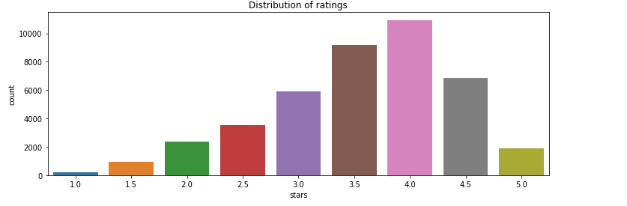
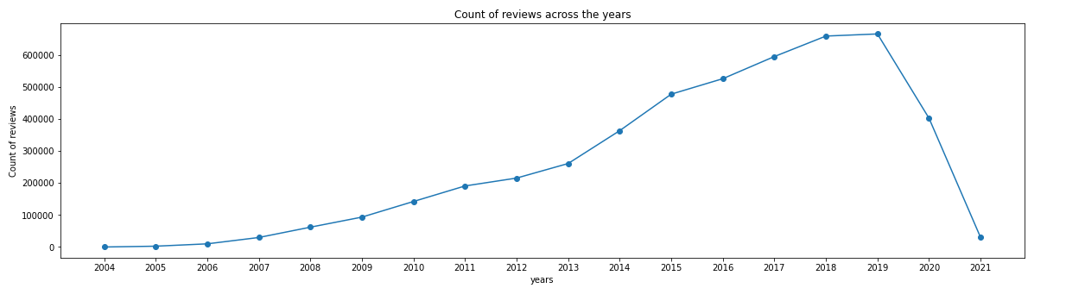
Exploratory Data Analysis
When representing ratings, the EDA of the Yelp data set provides insight into the patterns in the data. We can observe from the graphs that the highest number of ratings out of 5 is 4, and the majority of the ratings are provided between 2013 and 2019, with a significant drop after 2019 owing to the epidemic.

Slide 5
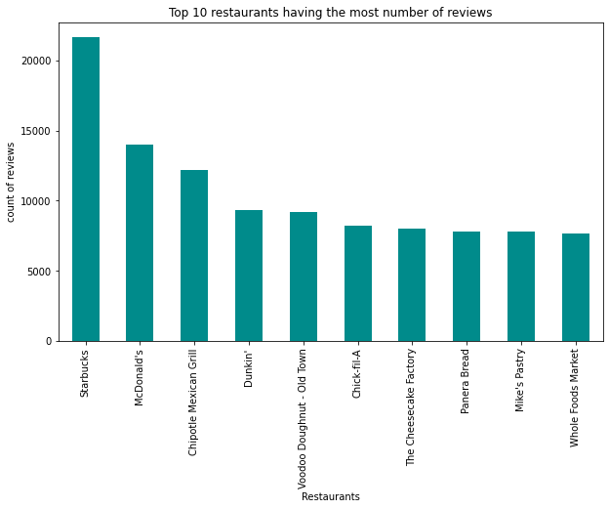
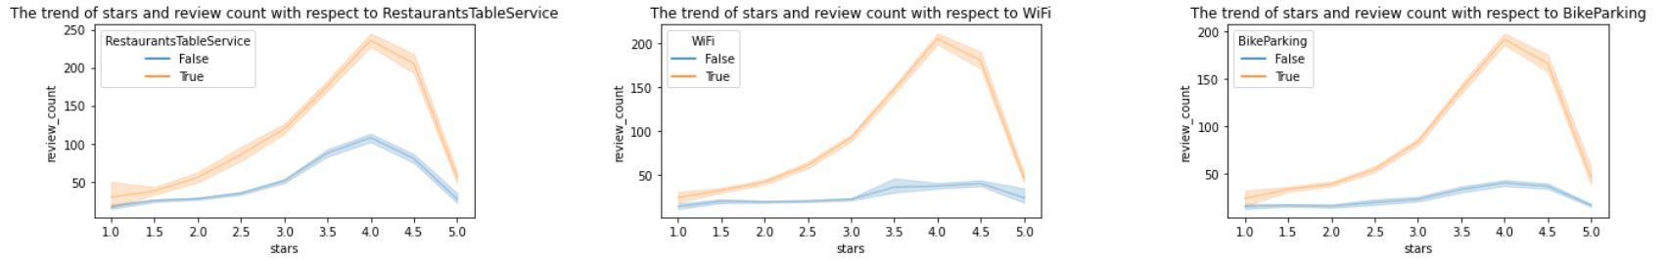
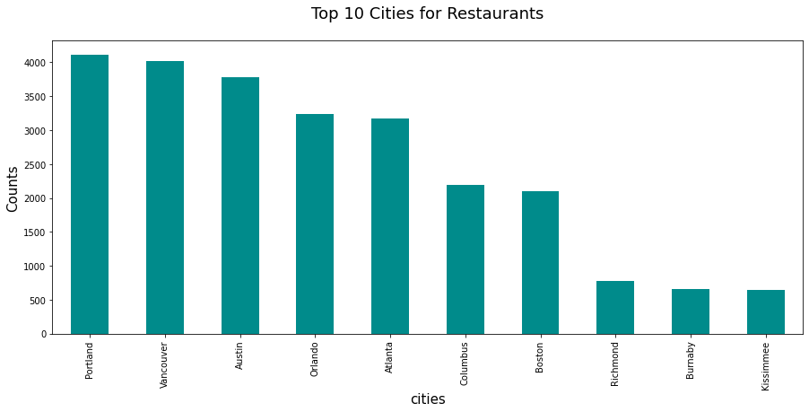
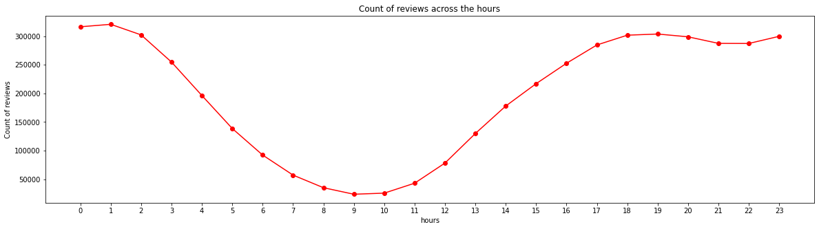

Slide 6
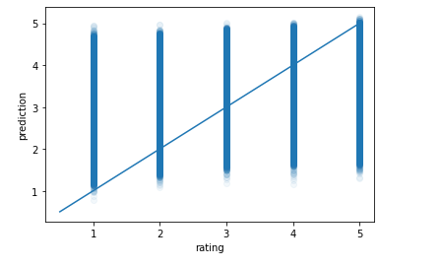
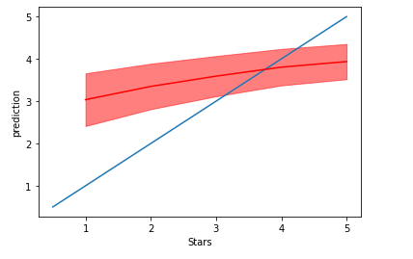
Modelling -1
Modeling approach
Revolves around the central dogma that “similar users rate similar restaurants similarly”
Rating history of user is captured to match user preferences to other similar/like-minded users to recommend restaurants
A baseline model is introduced to establish a basis for evaluating improvements in different collaborative filtering models. A naïve model identifies similar users and restaurants by using a hardcoded similarity function

Slide 7
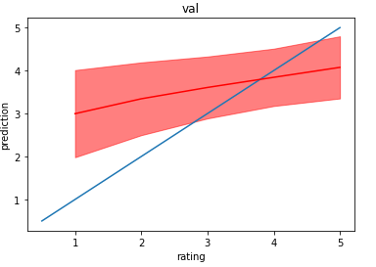
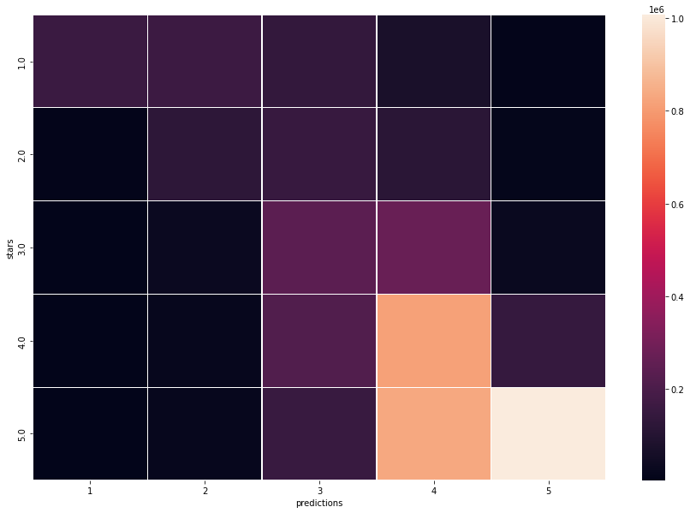
Modelling - 1
User preferences are not captured directly as part of the dataset for generating recommendations but rather through Latent factors (properties of users/items that inherently influences the user ratings)
Latent-factor based approaches relate users and items in a low-dimensional latent feature space.
Goal of the Model is to estimate the latent factor vectors such that the predictions minimize a loss function over the observed ratings•
We have used the widely used Stochastic Gradient descent and Adam optimizers to find the approximate estimates of the feature vectors while training the model

Slide 8
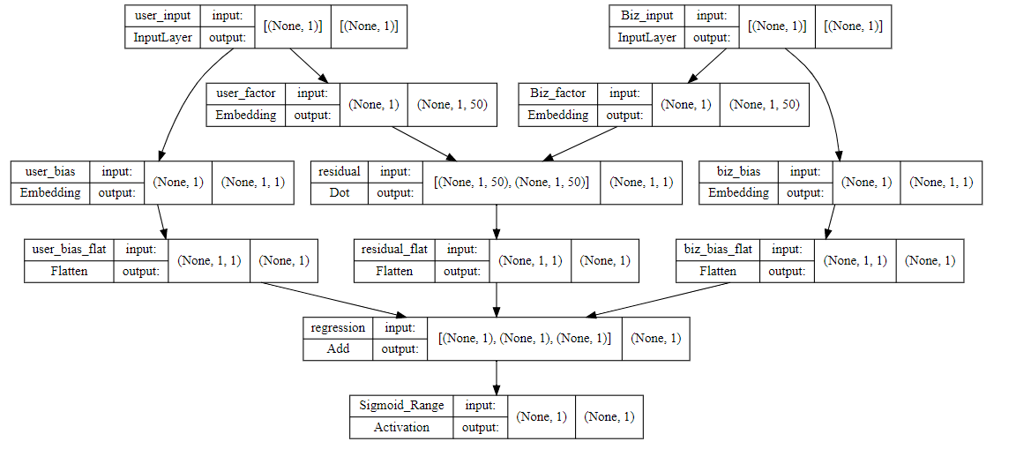
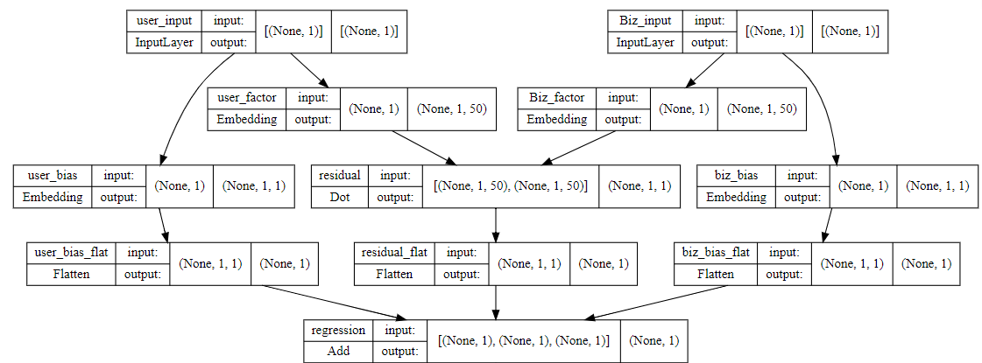
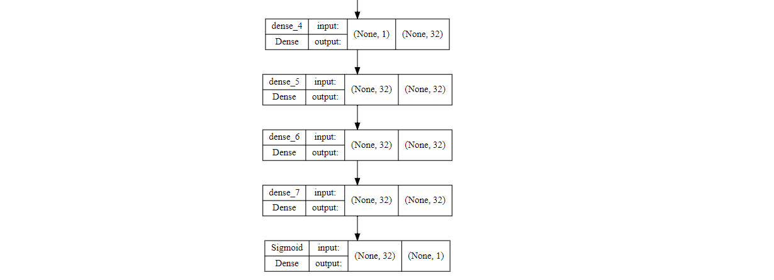
Regression Model -1
Regression Model -2

Slide 9
Modelling - 2
We have developed a recommendation logic that takes into account user's proximity to the restaurants they visited and also the recommendations of their friends.
We filter through the user's review history to find the most visited cities. We then check for the top restaurants with at least a 100 reviews to get a better result.
If the user has friends, we then look at their history if they have written at least 100 reviews, and filter out their top rated restaurants and recommend them to the user.
Finally we pass these restaurants as an input to our model and filter only those whose predicted rating is greater than 4 to give a top rated restaurant that that the model believes will also be liked by the user.

Slide 10
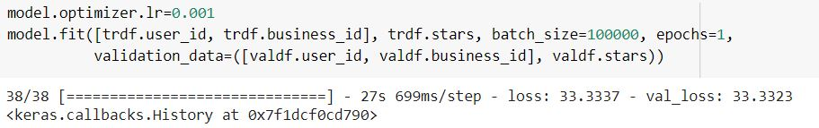
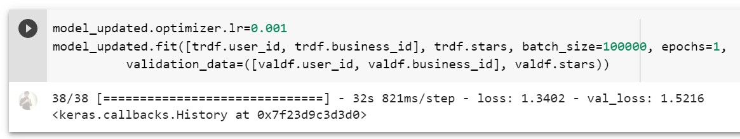
Interpretations
Regression Model -1 Results SGD Optimizer
Regression Model -2 Results Adam Optimizer

Slide 11

Conclusion
Model based on Adam optimizer outperforms the SGD optimizer
Adding an extra dense layer results only in marginal improvement in validation loss
Predictions are improved when we incorporated additional filters while candidate generation

